Slide 1
RSA
A public Key Algorithm

Slide 2
RSA
by Rivest, Shamir & Adleman of MIT in 1977
based on exponentiation in a finite (Galois) field over integers modulo a prime.
It supports key management concept, it is key generation.
Notes:
RSA is the best known, and by far the most widely used general public key encryption algorithm.

Slide 3
RSA
RSA makes the public and prívate keys by multiplying two large prime numbers p and q
Its easy to find & multiply large prime No. (n=pq)
It is very difficult to factor the number n to find p and q
Finding the private key from the public key would require a factoring operation
The real challenge is the selection & generation of keys.
RSA is complex and slow, but secure
100 times slower than DES on s/w & 1000 times on h/w.

Slide 4
Algorithm
P, Q
N=P*Q
E=such that it is not a factor of (P-1)*(Q-1)
(D*E) mod (P-1)*(Q-1)=1
CT=PT^{E} mod N
Send CT
PT=CT^{D} mod N

Slide 5
Example
P=7, Q=17
119=7*17
(7-1)*(17-1)= 6*16 =96 factor 2 & 3, so E=5
(D*5) mod (7-1)*(17-1)=1, so D=77
CT=10⁵ mod 119 =100000 mod 119 =40
Send 40
PT=40⁷⁷ mod 119 = 10

Slide 6
RSA Security
It uses prime number theory which make it difficult to find out the key by reverse engineering.
Mathematical Research suggests that it would take more than 70 years to find P & Q if N is a 100 digit number.

Slide 7
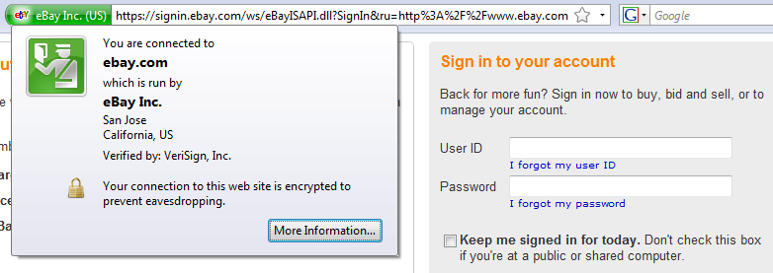
HTTPS
Secure Web Pages typically use RSA, Diffie-Hellman, and a symmetric algorithm like RC4
RSA is used to send the private key for the symmetric encryption

Slide 8
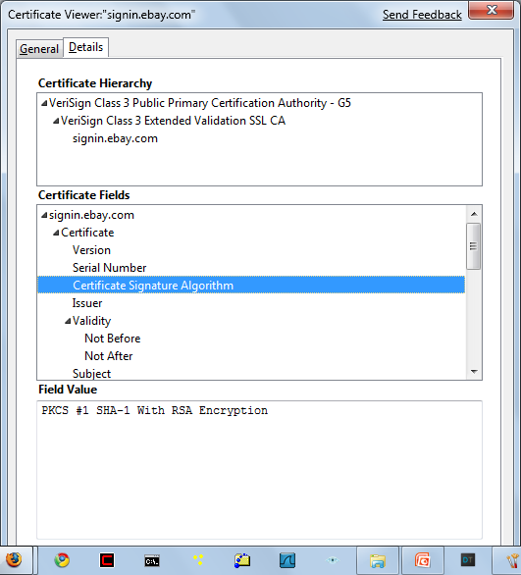
RSA Used by eBay

